Slide 1

Introduction to Funding Regulatory Plant Pathogen Research
Apply for Plant Protection Act Section 7721 – Plant Pest and Disease Management and Disaster Prevention Program Funding
PPA 7721 PPDMDPP Members:
Kelsey Bakken
Chelsea Carey
Glorimar Marrero
Lindsey Thiessen
Julie Van Meter

Slide 2
Overview of Presentation
Overview of PPA 7721
The Implementation Plan
Submitting a PPDMDPP Suggestion & ServiceNow
Things to Consider and Components of a Good Suggestion
PPDMDPP Goal Areas
List of Resources
Information Presented

Slide 3

What is PPA 7721?
What is PPA 7721? (1 of 2)
Under the Plant Protection Act Section 7721 USDA’s Animal and Plant Health Inspection Service (APHIS) offers funding for projects that enhance our ability to safeguard agriculture and facilitate safe agricultural trade.

Slide 4
What is PPA 7721? – (2 of 2)
What is PPA 7721? (2 of 2)
Plant Pest and Disease Management and Disaster Prevention Program (PPDMDPP)
National Clean Plant Network

Slide 5

The Plant Pest and Disease Management and Disaster Prevention Program (PPDMDPP)
Under the PPDMDPP, APHIS funds projects in six goal areas:
  1. Enhance analysis and survey
  2. Targeting domestic inspection
  3. Enhance pest identification and technology
  4. Safeguarding nursery production
  5. Outreach and education
  6. Enhance mitigation and response

Slide 6
Goal Area 1A & 1S Objectives
Goal 1A: Enhance Plant Pest and Disease Analysis
Develop analytical tools or methodologies that help APHIS or state partners identify or define pests and pathway risks using available data.
Develop risk-based models and decision-support algorithms, approaches, or tools to reduce the entry, establishment, and spread of plant pest species.
1A
Goal 1S: Enhance Plant Pest and Disease Survey
Conduct national priority pest surveys, and provide taxonomic expertise and increase capacity in support of agriculture crops, specialty crops, trade, and identified program surveys.
Target multiple high-risk pathways across the United States to prevent exotic plant pest introductions and improve preparedness and response capabilities.
1S

Slide 7

Goal Areas 2 & 3 Objectives
Refer to appendix E for canine utilization
Goal 2: Targeting Domestic Inspection
Promote and expand inland inspections of high-risk pathways for regulated articles
and plant pest movement.
Expand the use of canine teams for domestic inspection activities (excluding
domestic survey/detection activities).
2
Goal 3: Enhance Pest Identification and Technology
Improve all aspects of early detection technologies and resources.
Develop or improve diagnostic tests, identification resources, and taxonomic expertise for high priority plant pests.
Perform systematic research, produce identification resources, and/or develop
additional expertise and capacity to improve the identification of important plant pests.
3

Slide 8
Goal Areas 4 & 5 Objectives
Goal 4: Safeguard Nursery Production
Develop science-based best management practices (BMPs) and risk mitigation
practices to exclude, detect, contain, and/or control regulated pests from the nursery production chain.
Support development or improvement of nursery certification programs, including
the harmonization of different certification programs (both inter- and intra-state).
4
Goal 5: Conduct Targeted Outreach and Education
Provide education and information to key groups.
Increase the number of people actively looking for and reporting high-consequence pests at vulnerable points along high-risk pathways.
Increase public awareness and support for high priority plant pest and disease
eradication programs and acceptance of control efforts.
5

Slide 9
Goal Area 6 Objectives
Goal 6: Enhance Mitigation Capabilities and Rapid Response
Develop or adapt new control technologies, tools, and treatments for use in plant health emergencies and/or established pest programs.
Improve the knowledge base, response options, and capabilities prior to the onset of a plant health emergency.
Support the use of existing tools and initial response protocols for the overarching goals of containment, control, and/or eradication of plant pests.
6

Slide 10
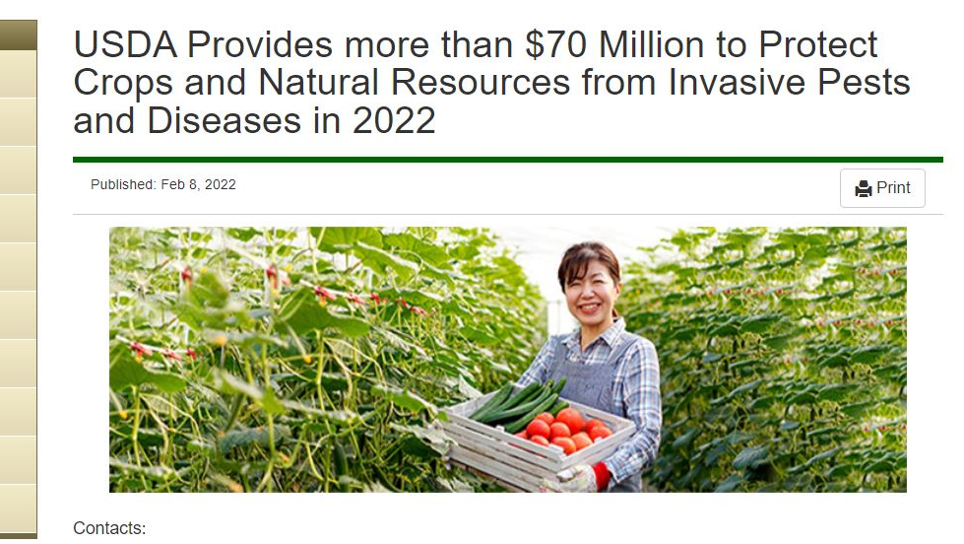




Steps to Implementation of the PPDMDPP
Implementation Plan Release
Implementation Plan provides details of PPDMDPP’s six goal areas for prospective submitters; May 2024
Open Period
June 5 – July 31
Submitters apply to the PPDMDPP through the ServiceNow online portal; tentatively June-August
Review Period
Suggestions are reviewed and ranked by a panel of reviewers; tentatively mid-August-November
Spending Plan Release
Spending Plan identifies projects that are receiving funding; tentatively February

Slide 11
Steps and Details of the Implementation of the PPDMDPP
Implementation Plan Release
Open Period
June 5 – July 31
Review Period
Spending Plan Release
Implementation Plan provides details of PPDMDPP’s six goal areas for prospective submitters; May 2024
Submitters apply to the PPDMDPP through the ServiceNow online portal; tentatively June-August
Suggestions are reviewed and ranked by a panel of reviewers; tentatively mid-August-November
Spending Plan identifies projects that are receiving funding; tentatively February

Slide 12




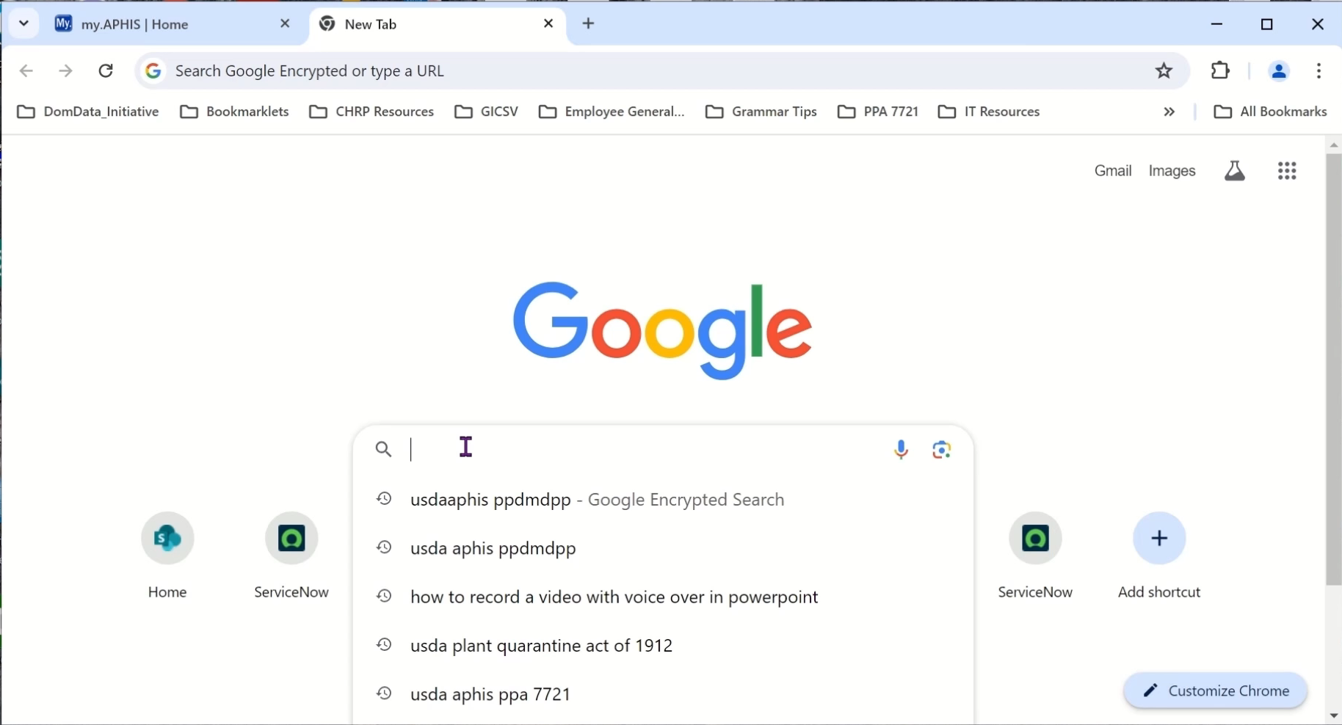
PPA 7721 Implementation Plan
Video clip
Notes:
Video Transcript:
In your preferred web browser search the keywords ‘USDA APHIS PPDMDPP’. If using Google or Bing the top search result indicated by the search engine should lead you to the homepage for the PPDMDPP. Here you’ll find all the information and related documents, including the Fiscal Year 2025 Implementation Plan, applicable to the funding opportunity. We recommend you bookmark this page, as I’ve already done here, because this page will contain links to accessing the online suggestion portal called ServiceNow, our Frequently Asked Questions, and our future webinar schedule. Now let’s look at the Implementation Plan.
The Implementation Plan is a key document describing the PPDMDPP’s six goal areas, the objectives and strategies, and critical information for submitting a suggestion. Let’s take a look inside. The table of contents provides an overview of the document and its sections and appendices and is hyperlinked for easy navigation. You can use ‘control click’ to move to specific goal areas if you don’t want to read the entire document. For example, if we only wanted to look at information for Goal 3, we could go there by easily clicking in the table of contents and then going to that specific area.
New for FY 25, we’ve worked with PPQ program areas and various pest groups to include information on PPQ priorities for those programs or pests. For example, if you work on the pest Box tree moth this section would be good to review to see if your suggestion is consistent with the priorities listed. We would find this information by going to Appendix B. Here you can see that program areas as well as program pests are listed. Suggestions do not have to be aligned with these priorities to be considered for funding. However, in this example if you were working on Box tree moth you can see here that we have various priorities listed.
In addition to the information on program areas and pests, we have appendices that have been updated to reflect the priorities of selected goal areas. If you are considering submitting a suggestion to Goals 1S, 2, or 3, we highly recommend you review appendices D, E, and F before you submit your suggestion. This concludes our video.

Slide 13






Who are Cooperators?
Non-profit Organizations
State Agencies
Colleges & Universities
Industry
Tribal Nations
Federal Agencies

Slide 14

What Are Cooperative Agreements?
Grants
Development of project without assistance from both parties
*Limited involvement
Cooperative Agreements
Both parties participate in the development of project objectives and activities
*Substantial involvement

Slide 15
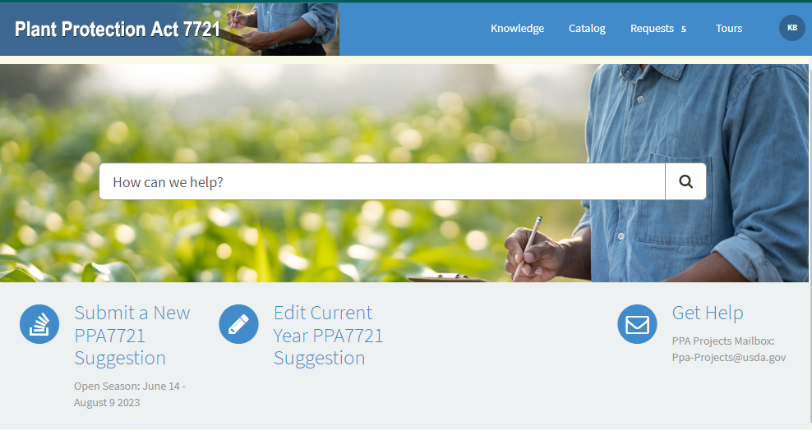
Where to Submit a PPA 7721 Suggestion (1 of 3)
Submit suggestions to ServiceNow, link available at: https://www.aphis.usda.gov/funding/ppdmdpp

Slide 16

Where to Submit a PPA 7721 Suggestion (2 of 3)
1
USDA system used to manage identity and login credentials for a variety of Department applications
Additional information available at https://www.eauth.usda.gov/eauth/b/usda/home
https://www.youtube.com/watch?v=CreYxWPxbak

Slide 17
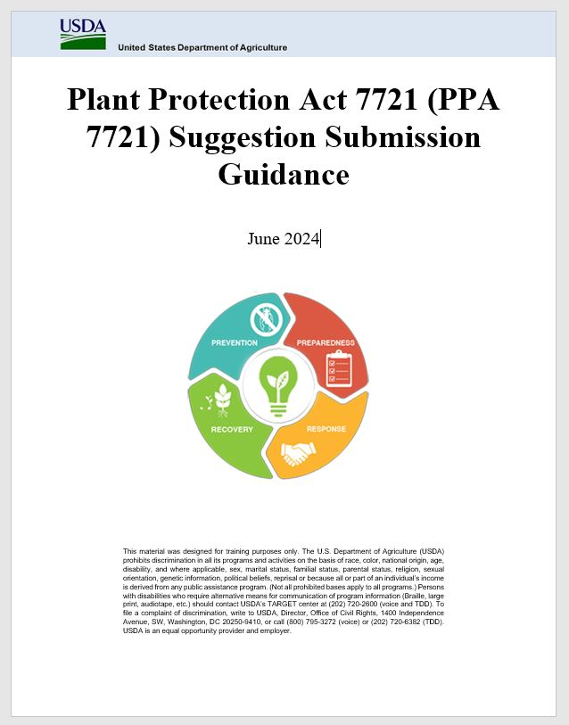
Where to Submit a PPA 7721 Suggestion (3 of 3)
Submit suggestions to ServiceNow, link available at: https://www.aphis.usda.gov/funding/ppdmdpp
Review the PPA 7721 Suggestion Submission Guidance document on the PPDMDPP web page
Notes:
Video Transcript:
Similar to accessing the Implementation Plan, the link to accessing the PPA 7721 ServiceNow platform will be available through the homepage for the PPDMDPP. By clicking on the link to the PPA 7721 ServiceNow Suggestion Submission site, the page will open in a new window or tab. Accept the ‘Terms and Conditions’ for using the site.
The PPA 7721 ServiceNow platform offers an easy to use, online portal for all suggestion submissions during the Open Period. A single user can submit one or multiple suggestions within the platform. Users will start a submission by clicking on the ‘Submit a New PPA 7721 Suggestion’ icon. This opens the suggestion form which contains a series of fields with fill in questions, drop down menus, and rich text boxes to enter suggestion details.
If you are applying from an academic institution pay special attention to information presented in the Implementation Plan and the PPA 7721 ServiceNow Suggestion Submission Guidance document regarding the ‘Cooperator Type’ field and the additional yes/no questions that follow when choosing ‘Academia’ as the cooperator type.
All fields must be answered before a suggestion can be successfully submitted. Any empty fields will be indicated in red at the bottom of the submission form. In this example, I have forgotten to select one or more strategies for which this suggestion aligns, as well as uploading a completed budget template. As a reminder don’t forget to upload the survey template if applying to Goal 1S, the budget template if applying to all other goal areas, and an accomplishment report, if applicable, before finalizing your suggestion.
Before we hit submit it’s important to note that you cannot copy and paste information from an Excel into fields for Abstract, Purpose, Technical Approach, Past Performance, and Milestones. Doing so will cause issues that cannot be reconciled on the Review side. But let’s hit ‘Submit’ anyways. We’ll receive a pop up notice that our submission is successful, and after hitting ‘Okay’ a new page will open with the suggestion details.
After reviewing the suggestion details if you need to edit your suggestion for any reason you can use the ‘Edit Suggestion’ icon located here on the right, or you can go to the home screen and choose the ‘Edit Current Year PPA 7721 Suggestion’ icon, and then select from the list of suggestions that you have submitted. You can edit the same suggestion multiple times. In addition, if you don’t have time to finish a suggestion from start to finish or get interrupted midway through the process, don’t panic(!). Enter random information into all fields of a suggestion [and then submit the suggestion], and then come back the suggestion and edit it when you have time.
Lastly, after submitting your suggestion you will receive an email asking you to provide feedback on your user experience. Please provide an answer to the one question that is asked and help us to continue to make improvements to ServiceNow for future PPA 7721 cycles. This concludes our video.

Slide 18
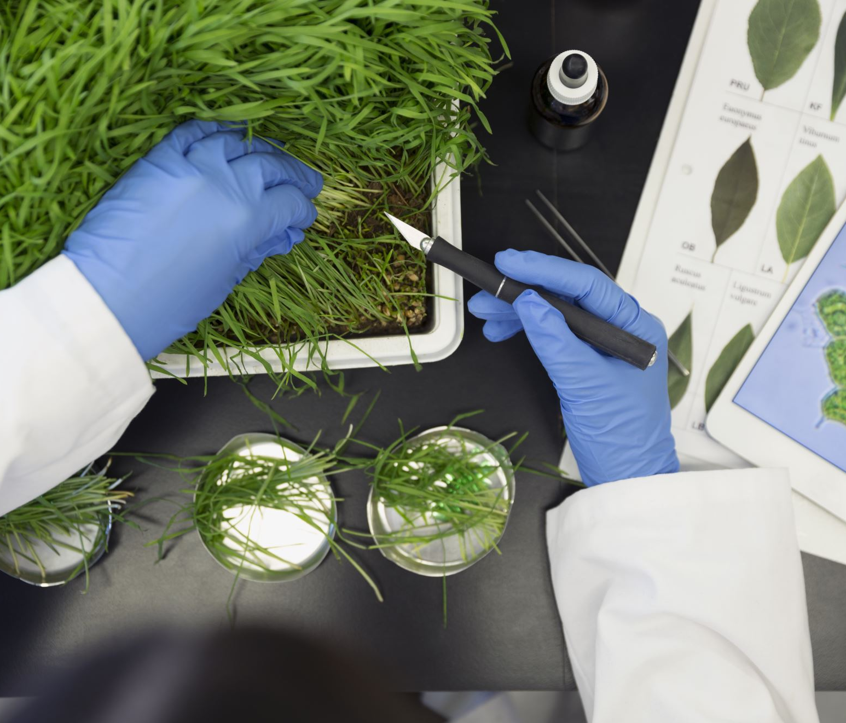
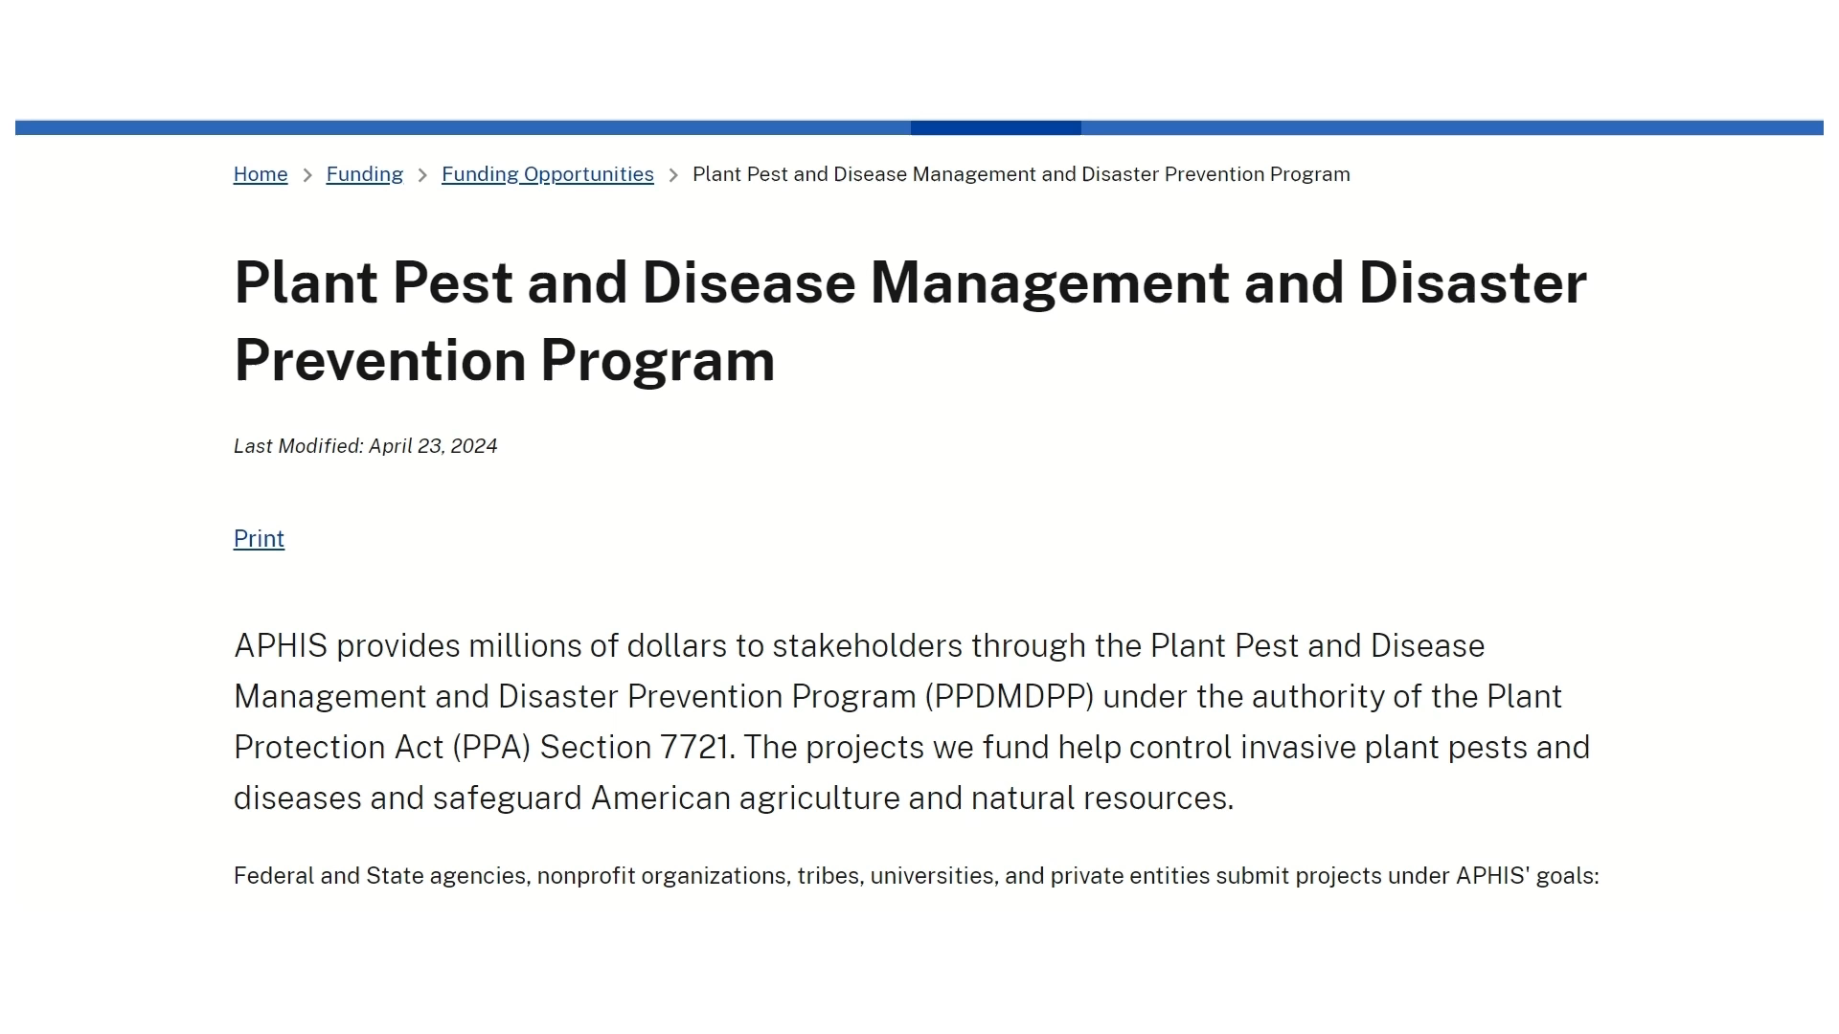
How to Use ServiceNow
Video clip

Slide 19
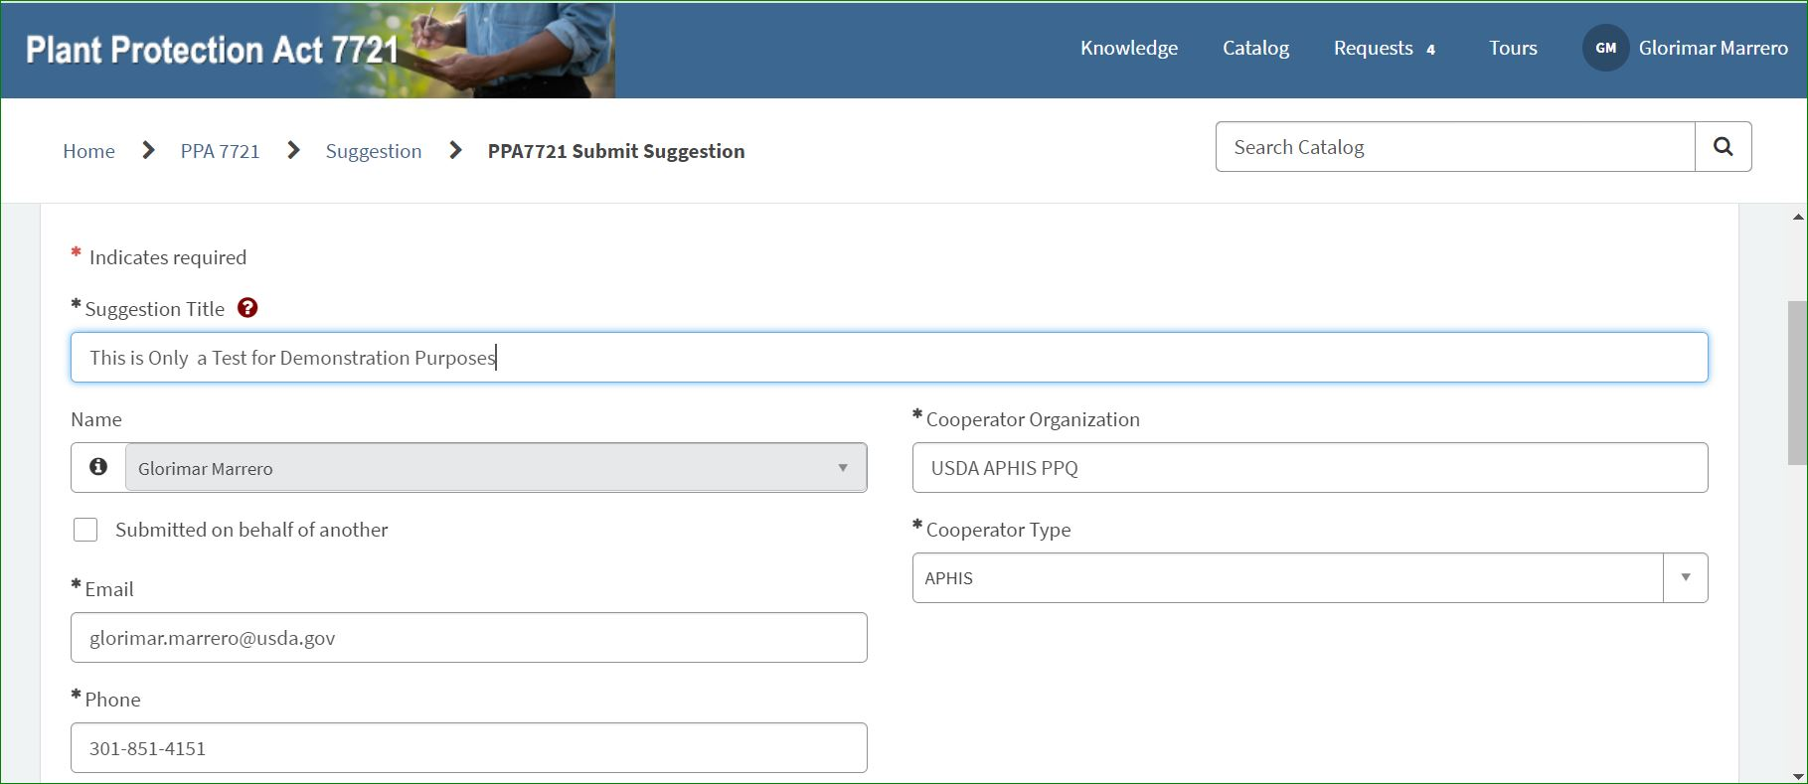
ServiceNow: Submitting on Behalf of Another (1 of 3)

Slide 20
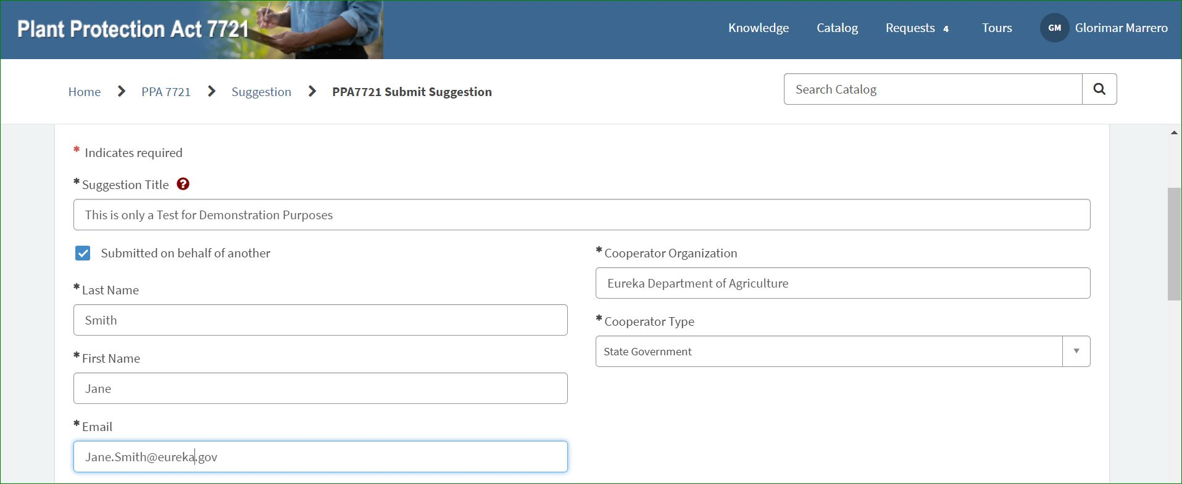
ServiceNow: Submitting on Behalf of Another (2 of 3)

Slide 21
ServiceNow: Submitting on Behalf of Another (3 of 3)
Important:
Listing the submitter incorrectly may cause downstream delays of funded projects.

Slide 22

ServiceNow: Suggestion Roles
Cooperator
Receives funds directly from PPQ
Enters into cooperative agreement
Contractor
Receives funds directly/indirectly from PPQ
Does not enter into cooperative agreement
Collaborator
Work as partners; do not receive funds from PPQ
2 questions directly related to this information!

Slide 23
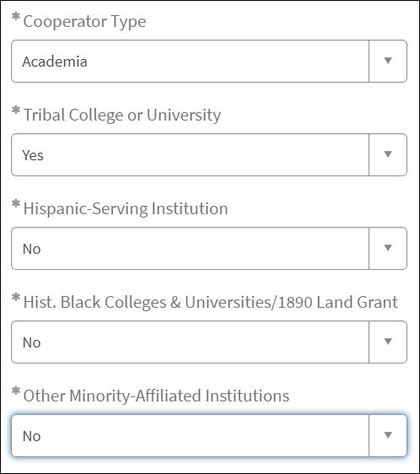
ServiceNow: Academia as Cooperator Type (1 of 3)
Tribal Colleges and Universities
Hispanic-Serving Institutions
Public institutions of higher education charted by federally recognized Indian tribes or the federal government, with majority Native American or Alaska Native student enrollment.
An academic institution, whether college or university, where Hispanic students comprise at least 25% of the full-time equivalent student body, according to the U.S. Department of Education, and is certified as a Hispanic Serving Institution by the U.S. Department of Education.
Up to $4M to support Tribes, Tribal organizations, Tribal colleges and universities, and minority-affiliated organizations and institutions.
HBCUs & 1890 Land Grant Institutions
Other Minority Affiliated Institutions
Minority Serving Institutions are institutions of higher education that serve minority populations. They are unique both in their missions and in their day-to-day operations.
Any historically black college or university (HBCU) that was established prior to 1964, whose principal mission was, and is, the education of black Americans and includes those historically black universities that were established under the Second Morrill Act of 1890.

Slide 24
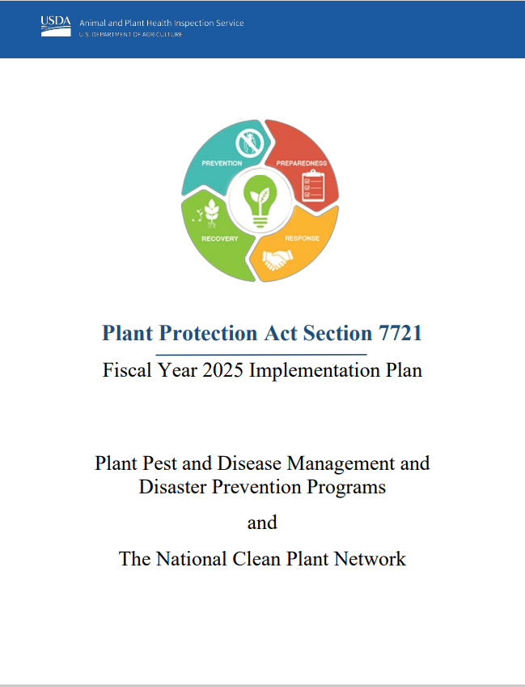


ServiceNow: Academia as Cooperator Type (2 of 3)
Up to $4M to support Tribes, Tribal organizations, Tribal colleges and universities, and minority-affiliated organizations and institutions.

Slide 25
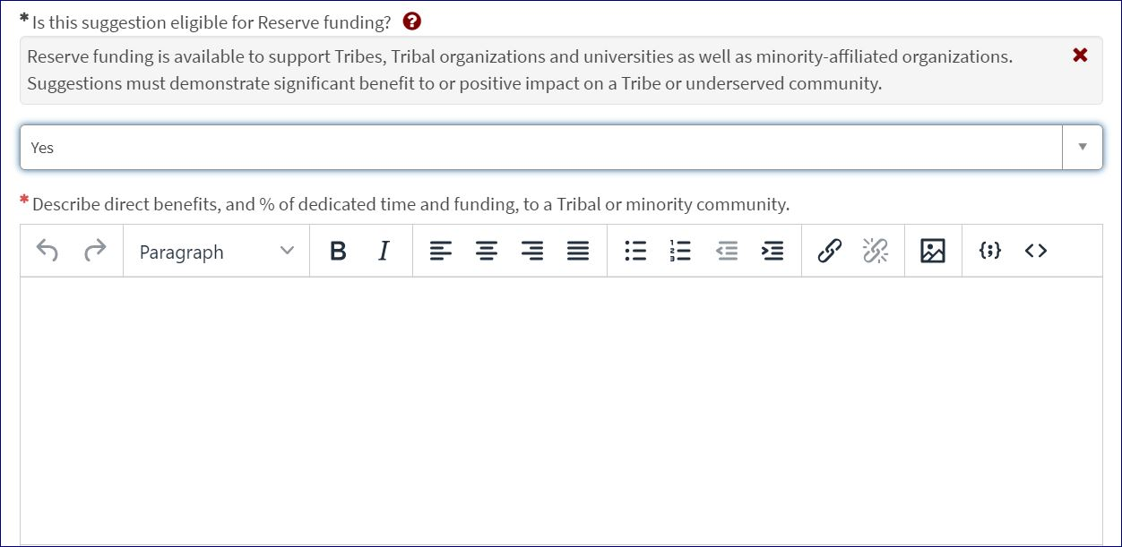
ServiceNow: Academia as Cooperator Type (3 of 3)
Up to $4M to support Tribes, Tribal organizations, Tribal colleges and universities, and minority-affiliated organizations and institutions.

Slide 26
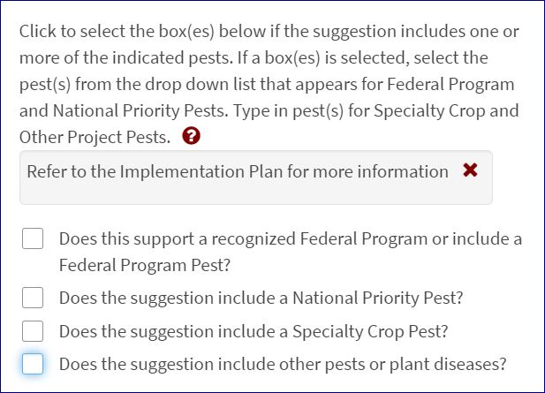
ServiceNow: Input for ‘Pest’ Fields (1 of 3)

Slide 27
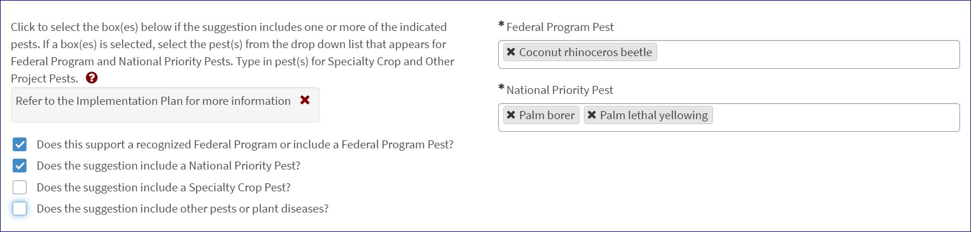
ServiceNow: Input for ‘Pest’ Fields (2 of 3)

Slide 28
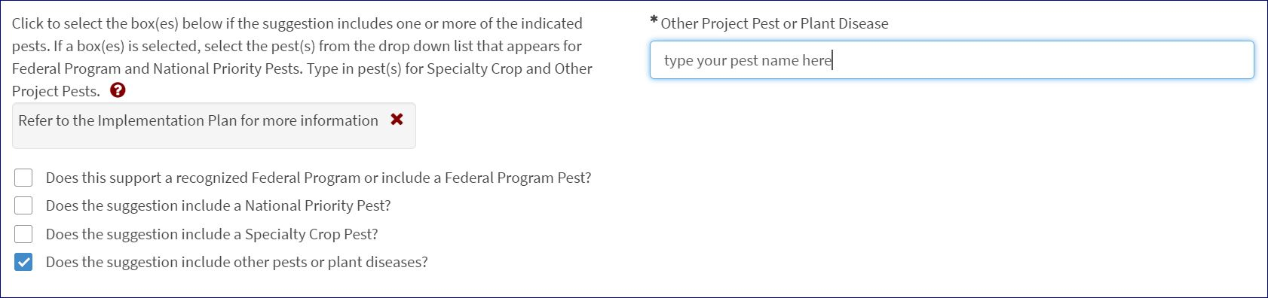
ServiceNow: Input for ‘Pest’ Fields (3 of 3)

Slide 29
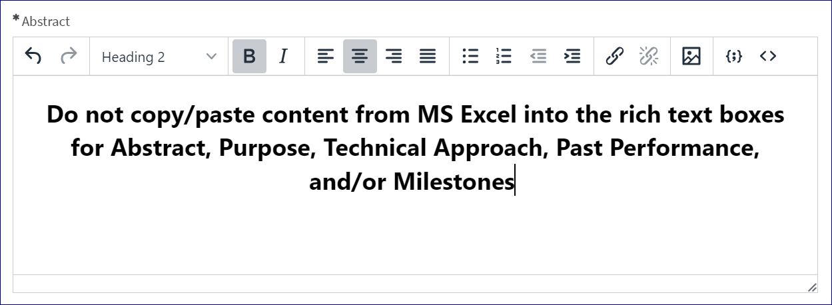



ServiceNow: Suggestion Edits or Retractions (1 of 3)

Slide 30
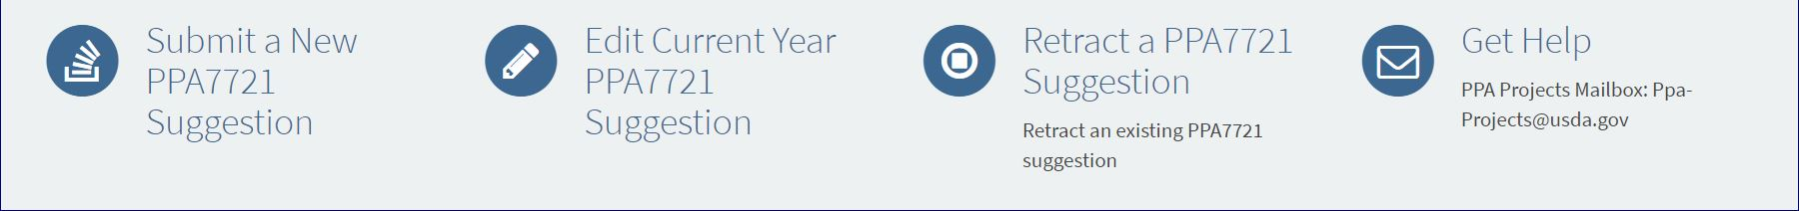

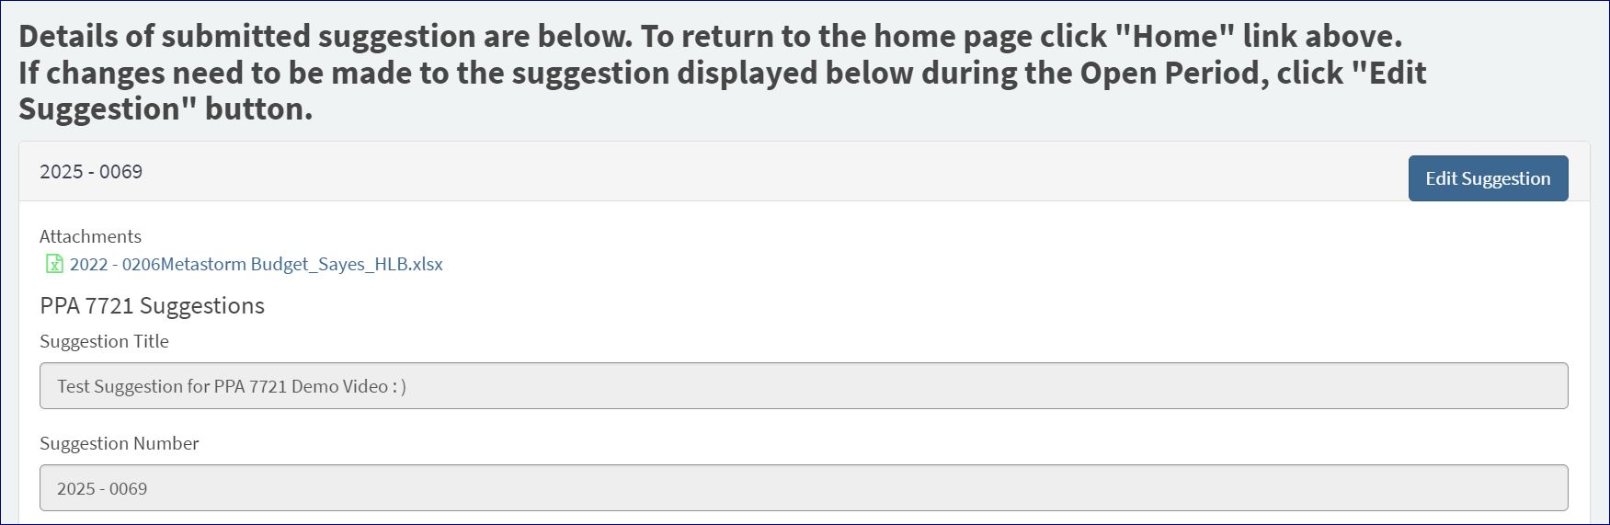

ServiceNow: Suggestion Edits or Retractions (2 of 3)

Slide 31
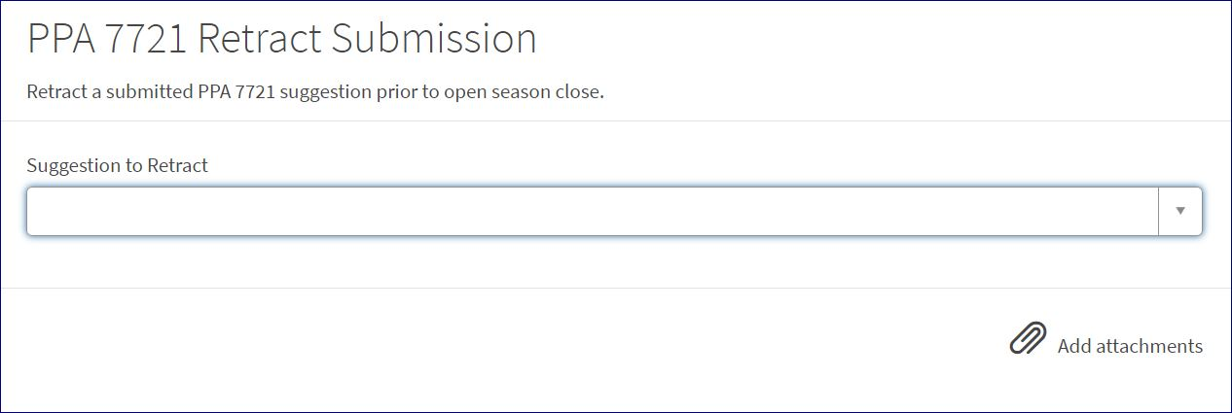
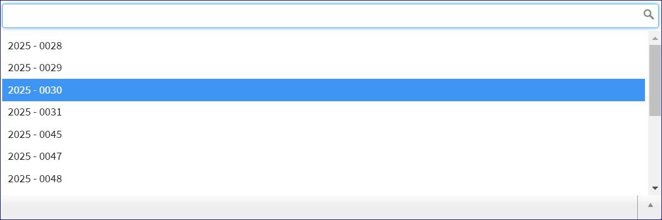
ServiceNow: Suggestion Edits or Retractions (3 of 3)

Slide 32
Questions to Ponder in…
Developing Suggestions
Who is the intended user?
Which regulated pathogen would be impacted from the project?
How will the tool or method be optimized?
Do I have all the required tools to develop the product?
What is the cost of the development of the tool or method, and of the end product?
What are the roles of each cooperator?
What are the measures of success?

Slide 33
Components of a Good Suggestion
(1 of 2)
Concise, descriptive title outlining activities
Clearly state all cooperators participating in the project and describe their specific activities with sufficient technical detail.
Detailed background information to justify the need for the work
Clearly outlined benefits to PPQ and stakeholders
1
1
2
2
3
3
4
4

Slide 34
Example 1 - Components of a good suggestion
The low rate of species level identification in intercepted materials supports our suggestion that molecular methods and updated identification tools should be employed to increase identification rates at ports of entry as well as in domestic surveys (i.e. CAPS), allowing USDA, state agencies, and other stakeholders to take more scientifically sound quarantine and control measures and ultimately expedite the movement of cargo and improve the quality of the surveys domestically.
3
Detailed background information to justify the need for the work
Outlines the benefit(s) that PPQ will gain from the research
4

Slide 35
Components of a Good Suggestion (2 of 2)
Objectives should be specific to a single year project, with longer-term projects providing distinct deliverables for the application year
Descriptive budget and justification that outlines the need for funds for each activity
Clear measures of success described throughout the project.
Descriptive budget for each participating cooperator and a justification that outlines activities
5
5
6
6
7
7
8
8

Slide 36
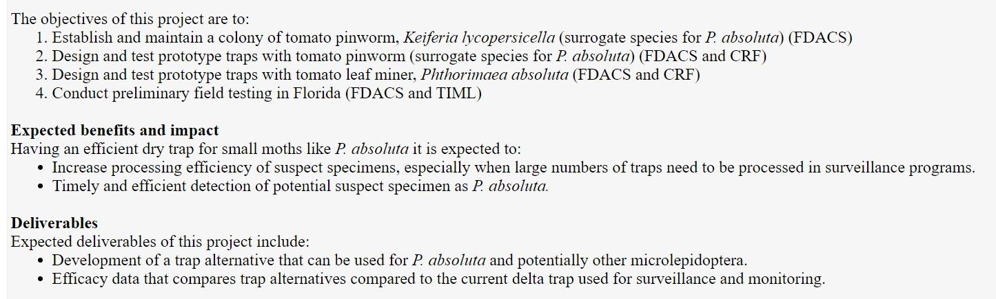
Example 2 - Components of a good suggestion
Clearly defined cooperator involvement by project activities.
2
Clearly defined objectives and deliverables appropriate for a single year project.
5

Slide 37
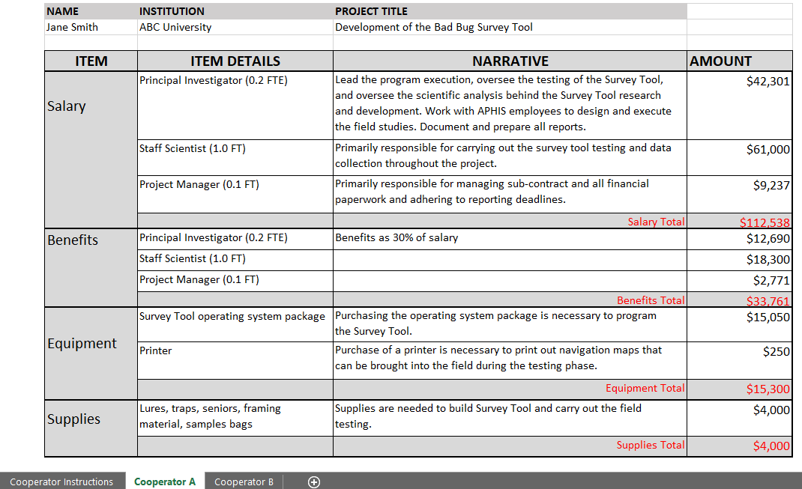
Example 3 - Components of a good suggestion
6
Descriptive budget and justification that outlines the need for funds for each activity
7
Budget for each participating cooperator & contractor

Slide 38
Review Process & Evaluation Criteria
Strategic Alignment
Plant Protection Act Section 7721
Impact/Outcome
Project Results
Feasibility
Resources, partnerships, process
Past Performance, Best Practices and Innovation
Budget
Internal and External Participants
Coordinated review
Leading to rating, then ranking of suggestions

Slide 39
Recap: PPDMDPP Timeline
Review Period
August – October
Decision Making
October–December
Open Period
June – July
Spending Plan Release
Tentatively Februrary
Suggestions submitted by cooperators
Reviewed by subject matter experts, State Plant Health Directors, State Plant Regulatory Officials, Cross Functional Working Groups, and Goal Teams
Funding decisions are reviewed by the PPA 7721 Cross Functional Working Group and PPQ Management Team
Spending plan posted to the PPA 7721 website and ADODRs contact cooperators receiving funding

Slide 40

Let’s go through a checklist
Review the FY 2025 Implementation Plan
  Identify the appropriate goal area for suggestion idea
  *must be a single goal area*
    Within the goal area, what objective and strategies will this project incorporate?
Develop suggestion activities with these components in mind:
  Concise, descriptive title
  Define specific activities for each cooperator
  Provide detailed background information
  Clearly outline benefits to PPQ and stakeholders
  Provide single year objectives and deliverables
  Describe budget and justification for funds
Submit suggestion during open period from
June 5 – July 31

Slide 41

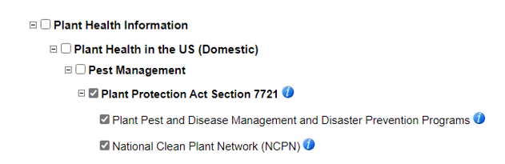


Resources
PPA 7721 Website:
https://www.aphis.usda.gov/funding/ppdmdpp
Stakeholder registry: https://public.govdelivery.com/accounts/USDAAPHIS/subscriber/new
Contact us at:
ppa-projects@usda.gov

Slide 42

Contribute to PPA 7721 as a Reviewer
We need subject matter experts to review suggestions during the review period
Benefits include
  CV/resume experience
  Behind-the-scenes knowledge of the PPA 7721 process
Contact us at ppa-projects@usda.gov
This Photo by Unknown Author is licensed under CC BY-SA-NC

Slide 43
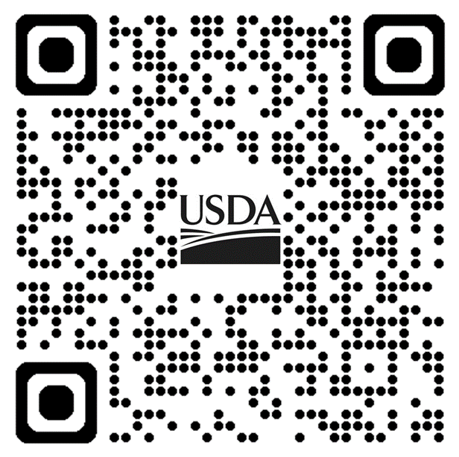




Any Questions?
?
PPDMDPP website https://www.aphis.usda.gov/funding/ppdmdpp

